Slide 1
The Interactive
White Board
A Great Tool for Instrumental Music Classes

Slide 2
Carole Smith Grooms
Freedom Middle School
Franklin, TN
Band and Strings, grades 7 & 8
The interactive white board in the Freedom Middle School band room was installed in December of 2012. We have just begun to implement its many possible uses in instrumental music classes!
There are several commonly used brands of interactive white boards, Promethean and SmartBoard, being just two of them. Some have touch-screen technology; ours does not.

Slide 3
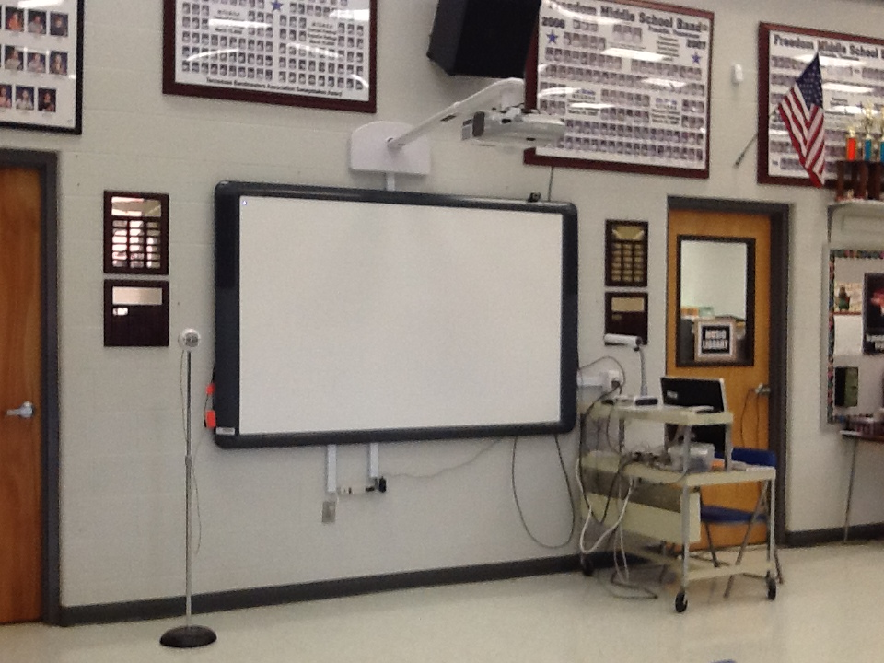
Freedom Middle School
Promethean Activeboard Pro 300

Slide 4
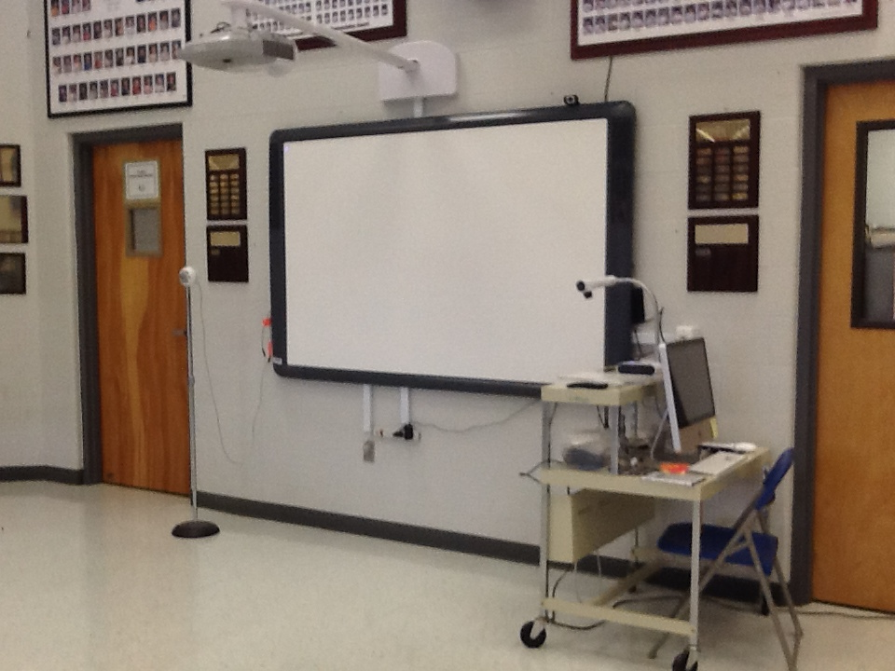
The board includes the short throw LCD projector.
Ours is used with an iMac and Elmo document camera.
We have added an external Snowball mic and a web-cam. The board has two interactive pens which work much like a computer mouse.

Slide 5
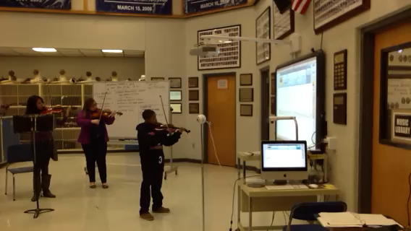
Since we are enthusiastic SmartMusic users, playing with SmartMusic on the board was a great place to start.
The board’s speakers are adequate for smaller classes to play with the recorded accompaniment. (video)

Slide 6
One of the most useful features of the interactive whiteboard is the ability to annotate, or write, on the screen, right over the display. The menu shown here includes the basic commands. You can choose color and line thickness as well as other tools. When finished, the circular red arrows icon resets the page so you can start again. You can also write over the plain white background, in the same manner you would use a marker board, but you “erase” the screen with the reset butoon. No mess – and fast! The display can be saved as a file for later reference.

Slide 7
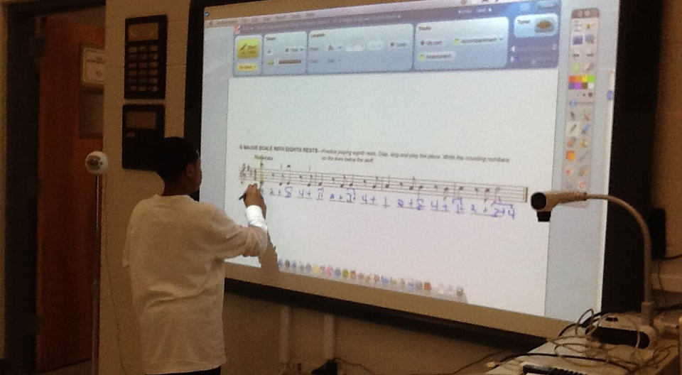
Here a student writes the beat counts underneath a line from his method book that is open in SmartMusic.

Slide 8
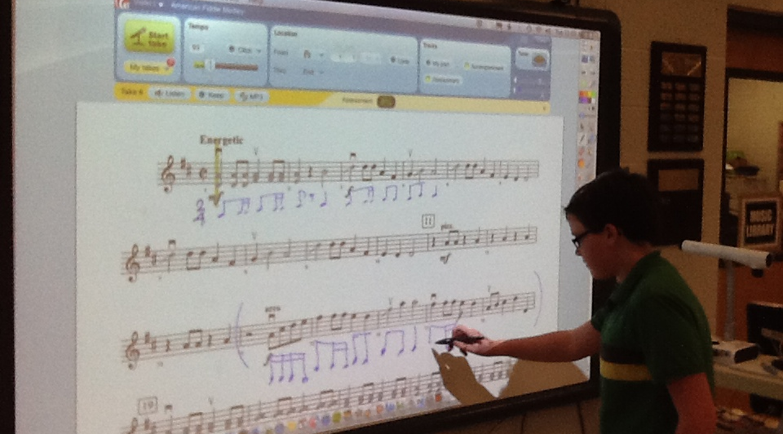
Here a student writes the corresponding 2/4 rhythm under a selection in 2/2 as the group reviews cut time. The music displayed is a selection being prepared for concert and is open in SmartMusic to the violin 1 part.

Slide 9
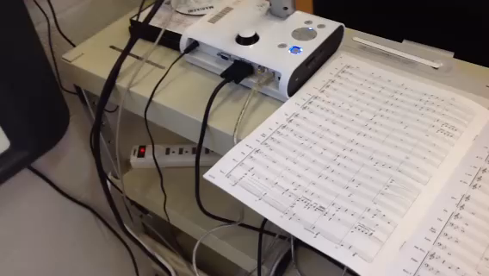
The Elmo document camera is handy for displaying a score to the class. You can use the pen tool to mark details or point out parts within the score. (video)

Slide 10
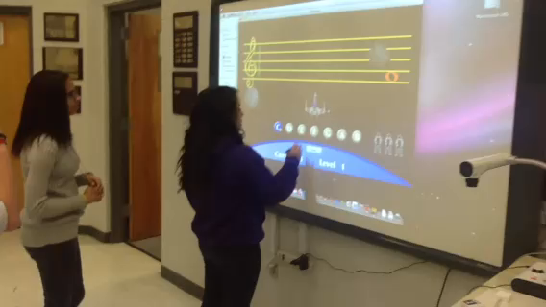
Students love playing some of the cool interactive music-learning games found on the Internet – like Staff Wars shown here. (video)

Slide 11
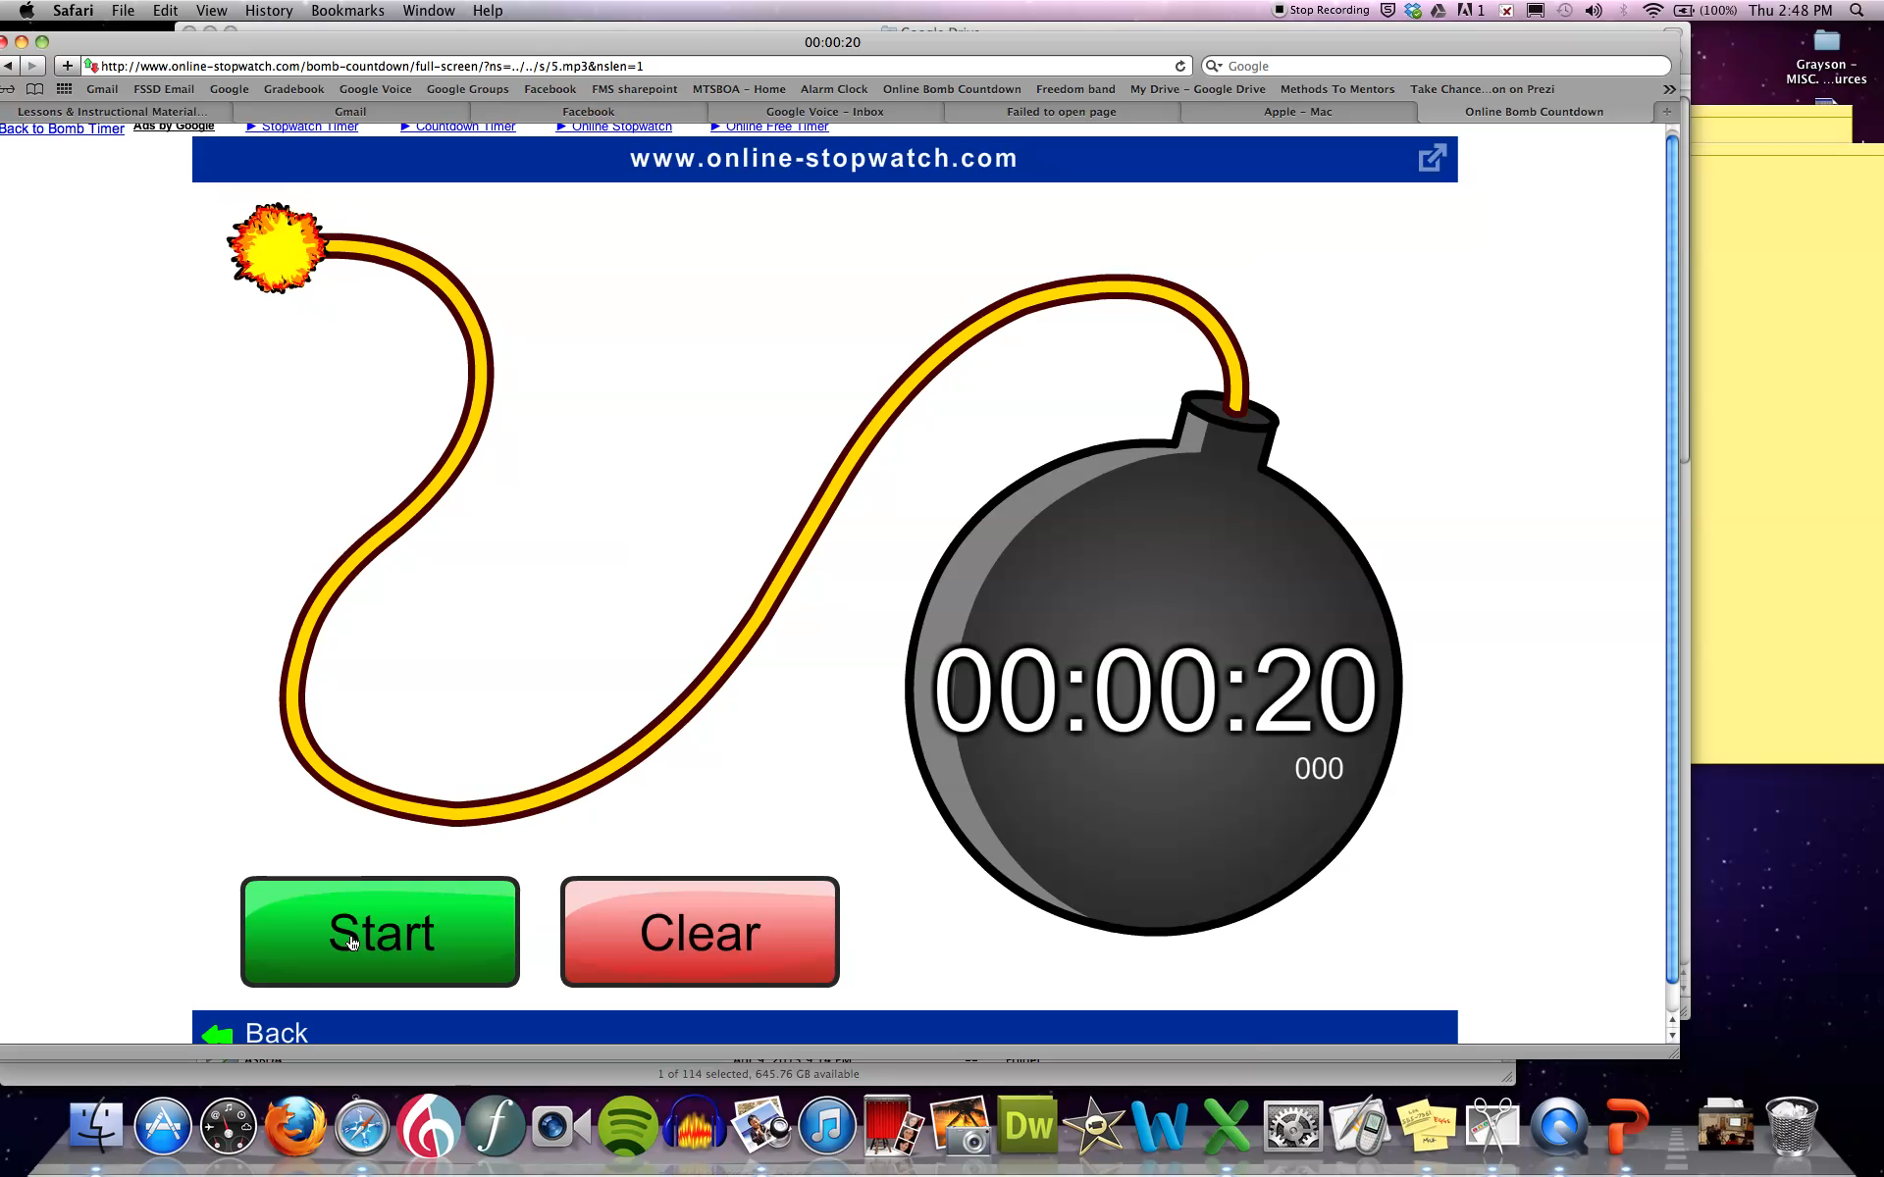
The board is a very effective place to display an online timer to let students know when they should be in their seat and ready to play! (video)

Slide 12
Displaying a tuner on the board makes it easy to involve the whole class when working on tuning. (This is the tuner in the SmartMusic tools.)

Slide 13
In addition to the tuner, using the metronome, click track and recording tools in SmartMusic is very handy since all commands can be done on-screen with the pen, or from somewhere else in the room with a tablet synced with the computer.

Slide 14
The Promethean Board comes with the ActiveInspire software that controls the interactive board features as well as enables the computer and smart board to interact.
The presentation application native to the board is called the “Flip Chart.” It is somewhat like Powerpoint in that it has pages like slides, except that all kinds of interactive features can be built into the presentation, allowing the teacher or students to manipulate objects on the screen.

Slide 15
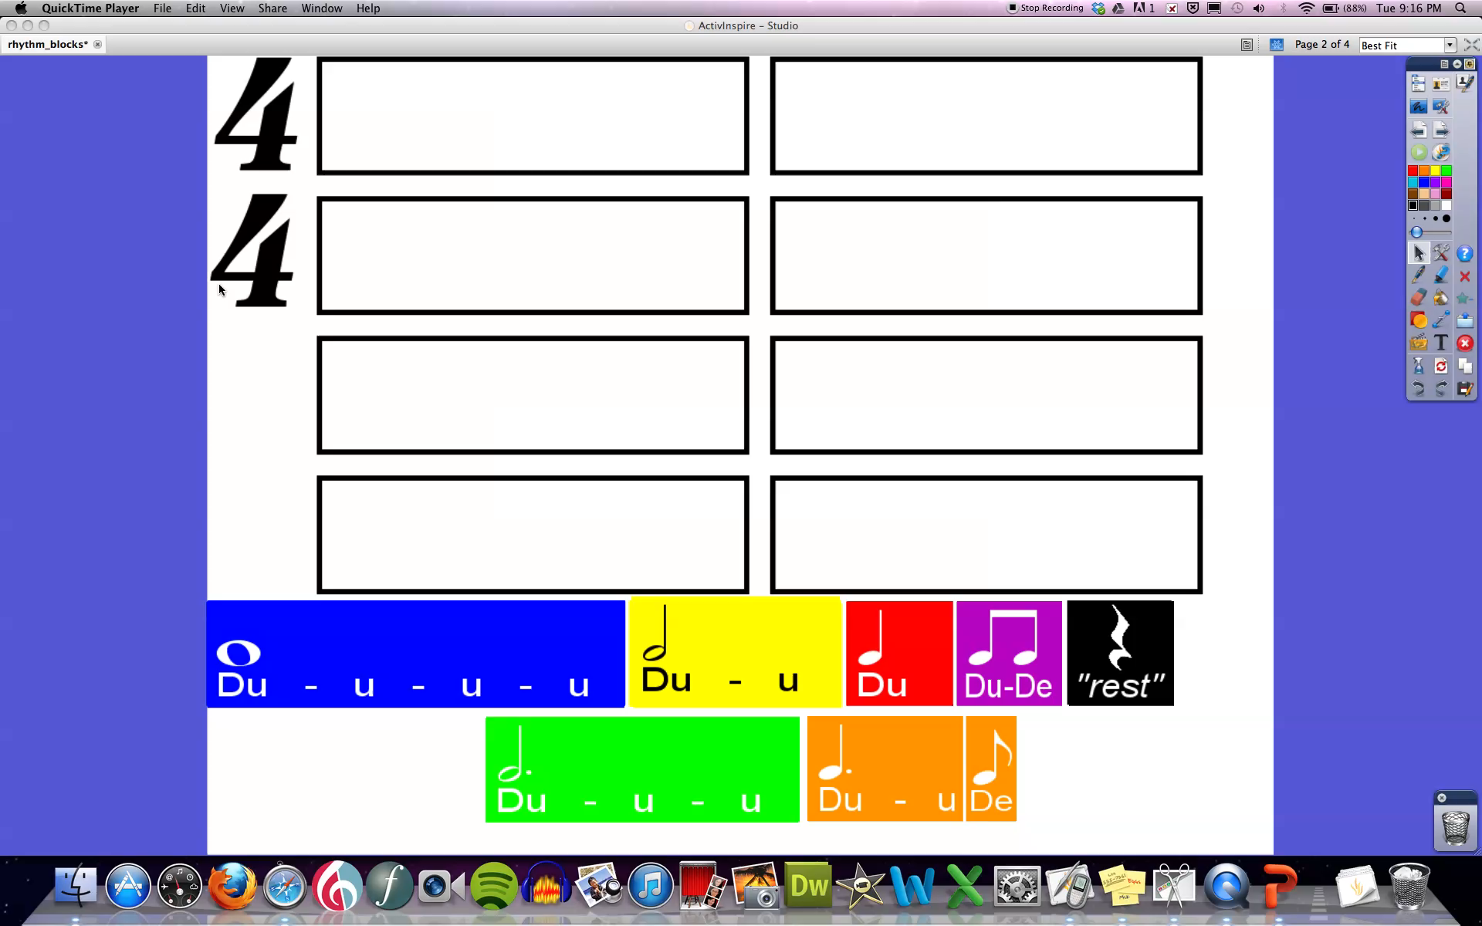
This Flip Chart, called Rhythm Builder, is an example of the type of teacher-made resource that can be created for the Activeboard. This one was downloaded from the Promethean Planet website. (video)

Slide 16
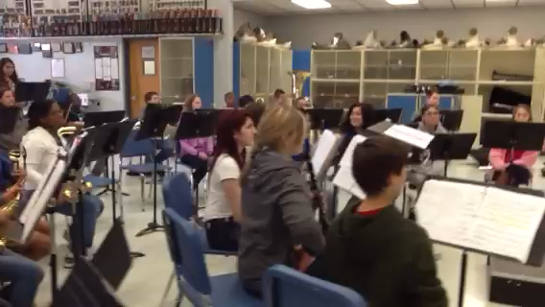
The web cam added to our board set up allows us to use video calling technology with a huge display for all students to see. Recently, Dr. Barbara McLain, from the University of Hawaii, led a rehearsal with the Freedom 8th Grade Band via Skype. (video)

Slide 17
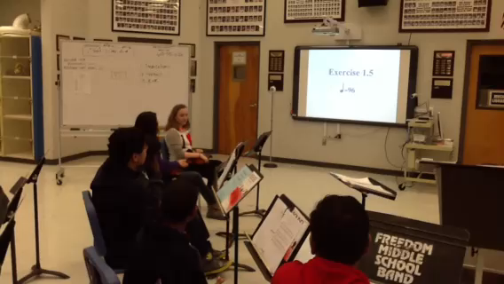
FLASHTRAX is another great application for the board. (Rhythm reading system DVD, by Randy Box.) It is great to be able to pause the DVD on a particular measure and have a student write in the counts underneath when a problem rhythm comes up. (video)

Slide 18
In our school, all academic teachers have the same Promethan board that we have in the band room. Many of them also have a clicker system that goes with the board and that allows students to “vote” an answer when this feature is incorporated into a flip chart. In addition, some teachers have a separate tablet that goes with the board which mirrors their computer screen and allows them to control the board from anywhere in the room. (I intend to use the iPad app “Splashtop 2” which does the same thing – just as soon as my tech department unblocks the Splashtop website on our internet filters.)
At this point, we have had our board only about four months and have barely scratched the surface of implementing its use into our classes. Particularly, I am looking forward to having time to learn to design and implement my own interactive flip charts. In the meantime, I would love to learn from other music teachers in TN who are using interactive white boards in their instrumental music classes!
Carole S. Grooms – April 2013

